Slide 1
Computer Networks Switching
Circuit Switching
Packet switching
Message switching

Slide 2
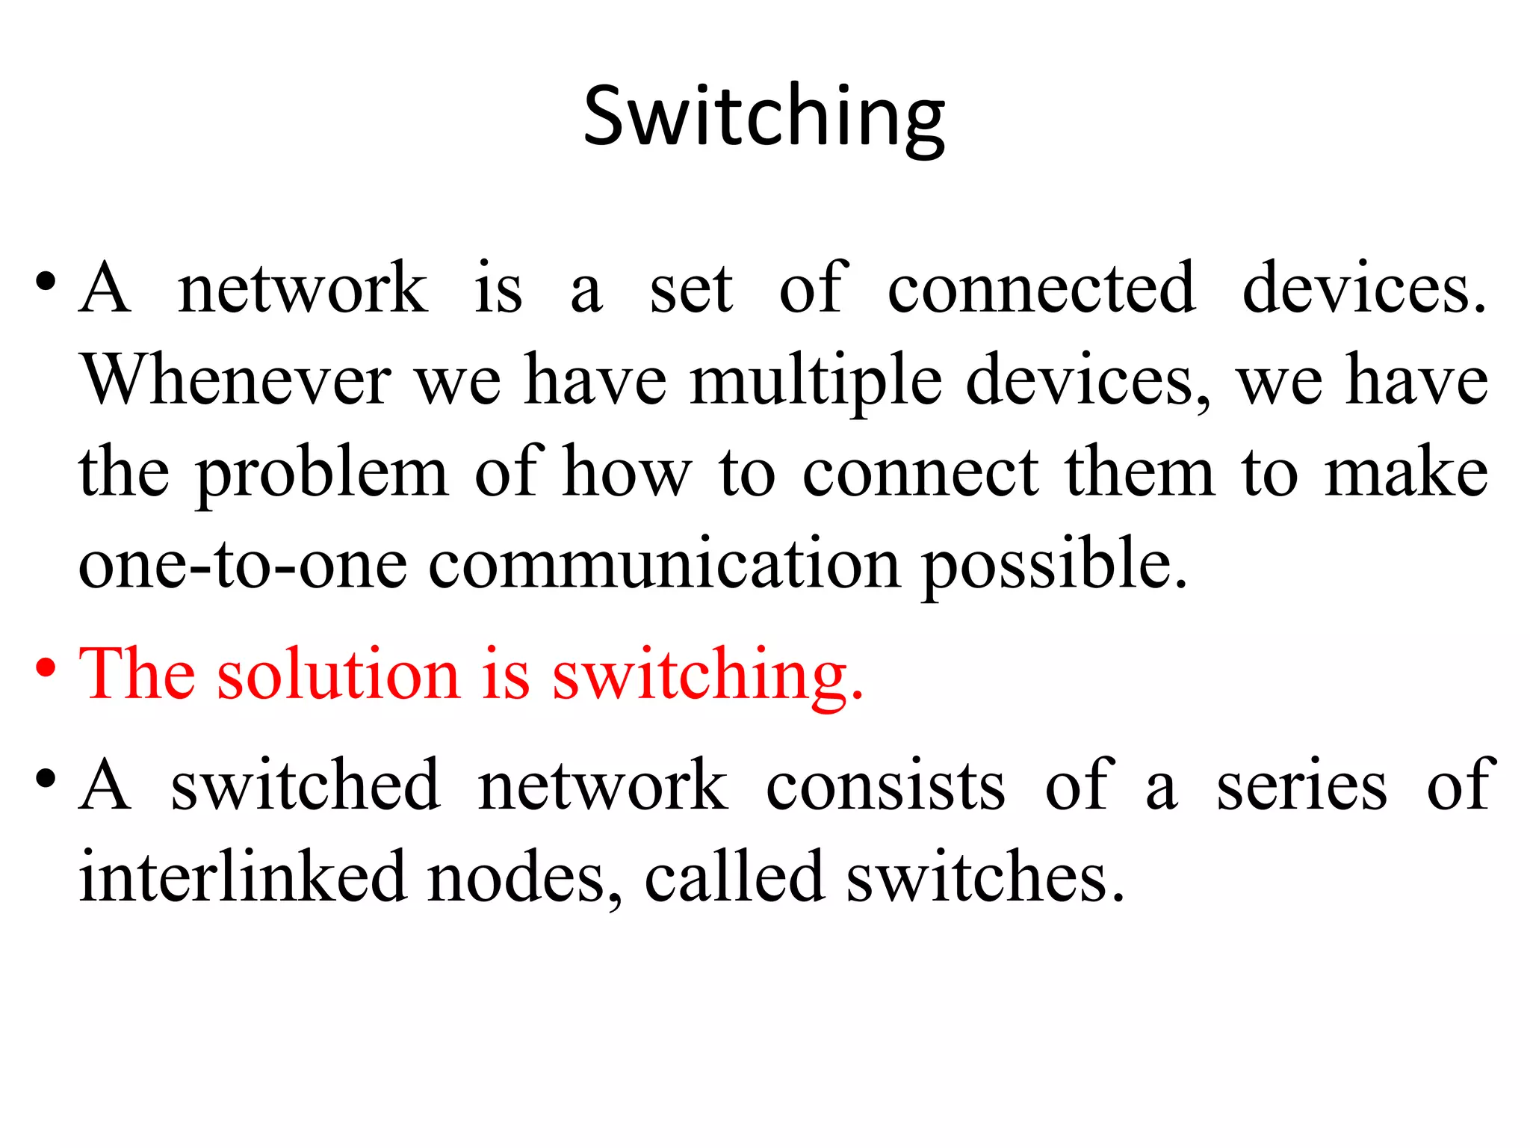
Switching

Slide 3
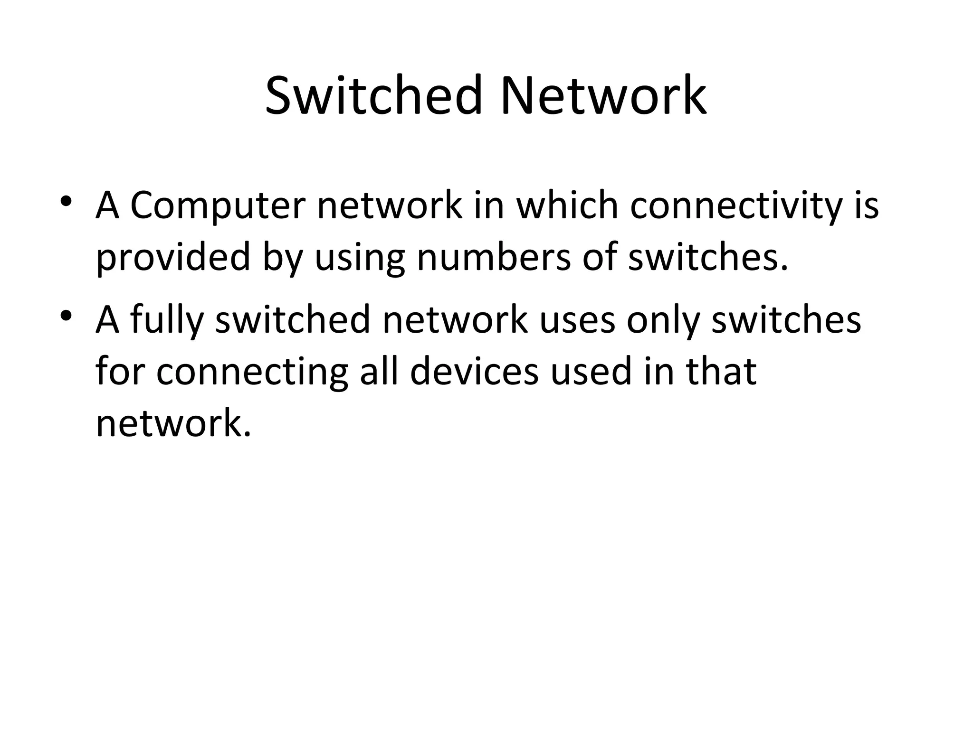
Switched Network

Slide 4
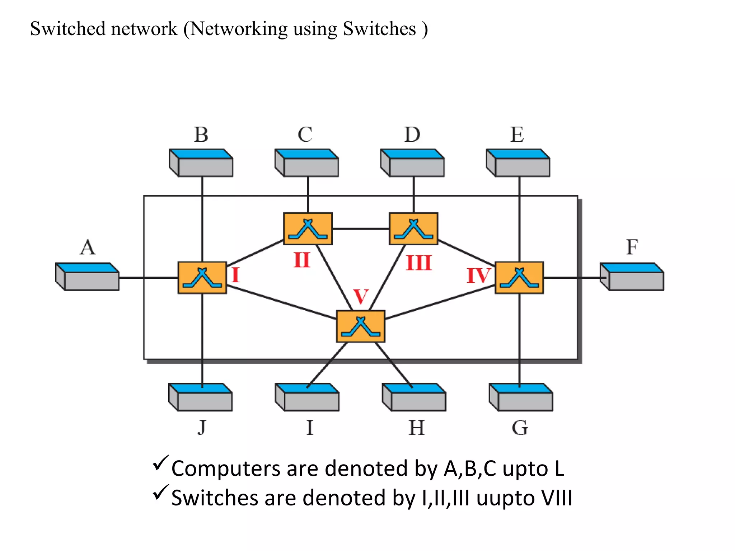
Switched Network

Slide 5
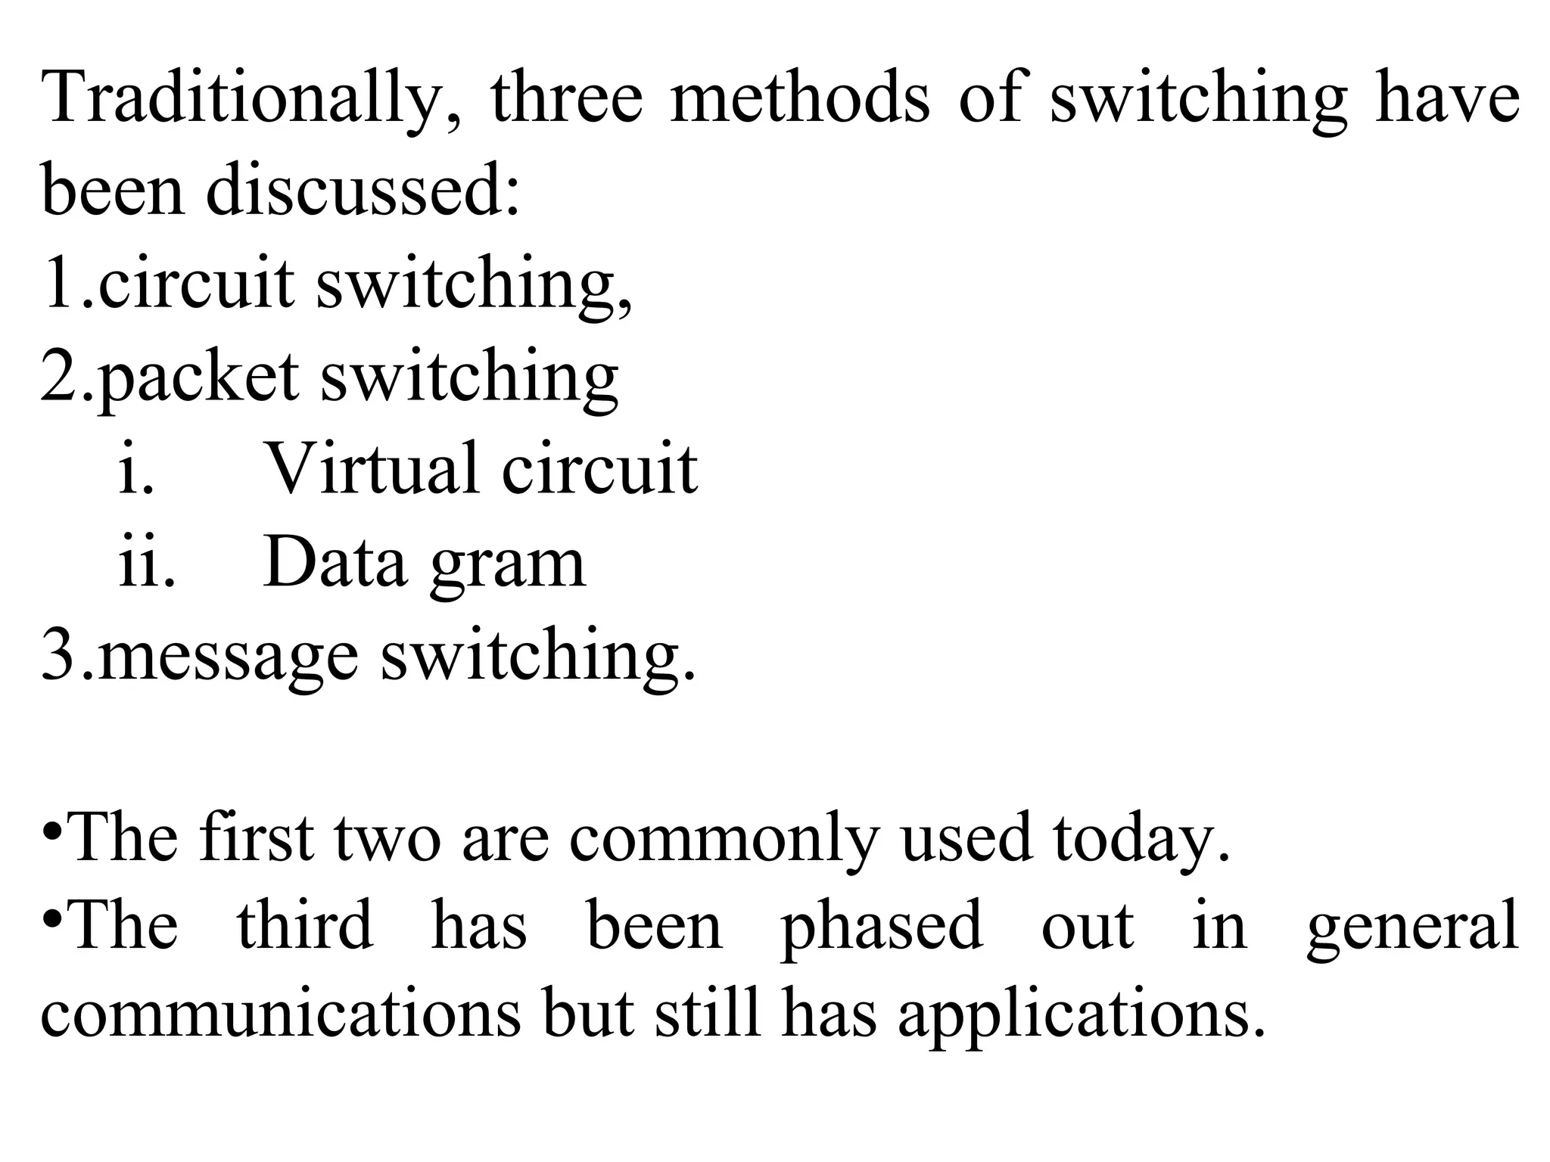
Types of switching

Slide 6
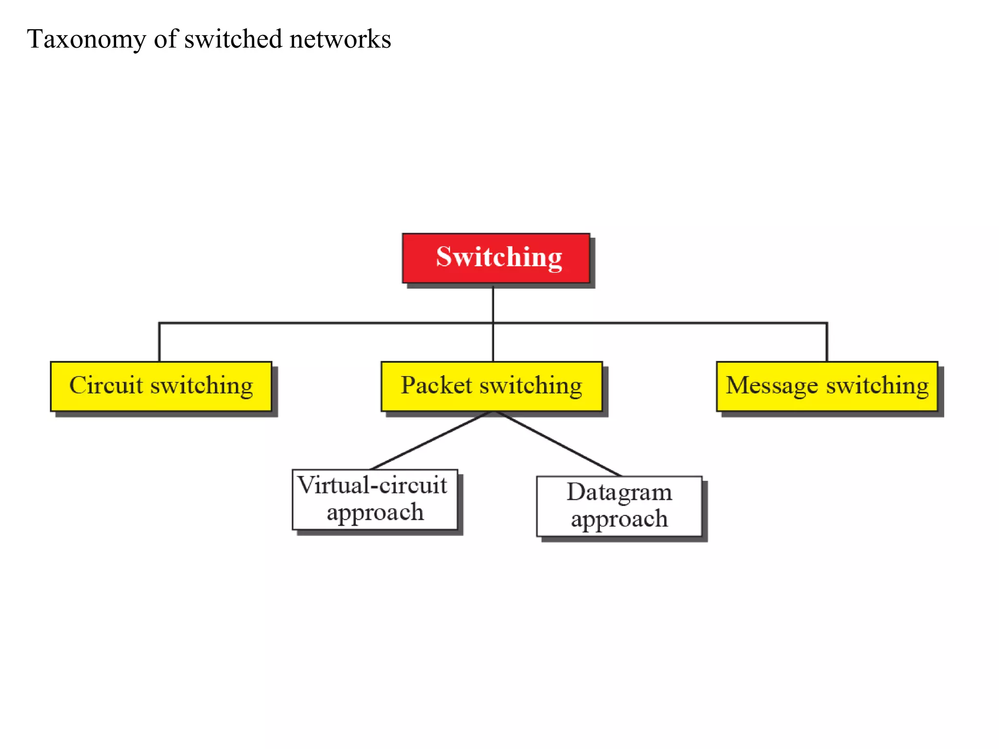
Switched network

Slide 7
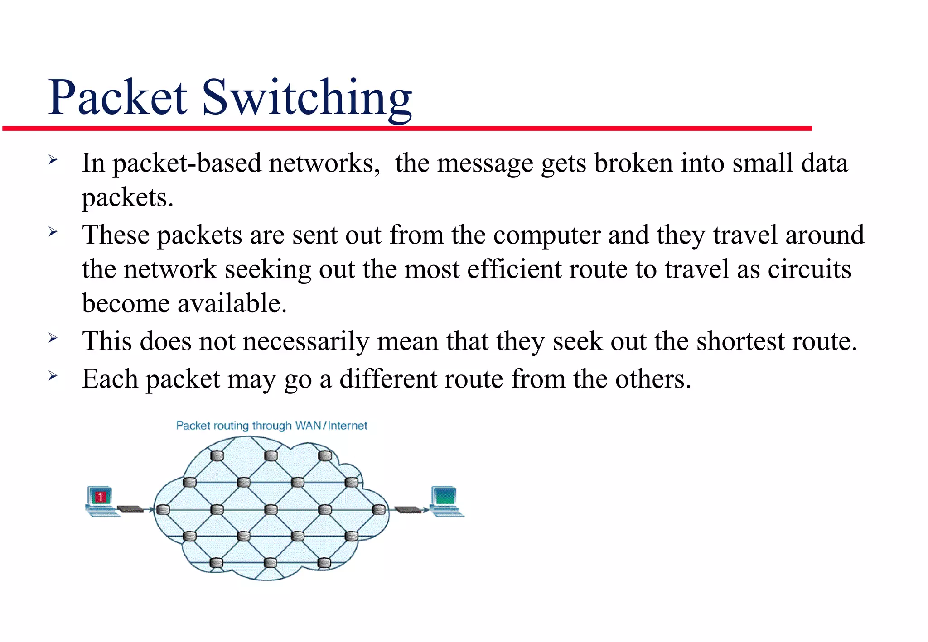
Packet Switching

Slide 8
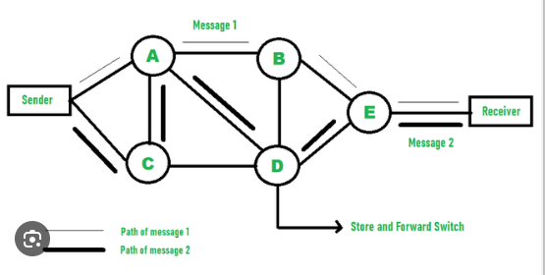
Packet Switching

Slide 9
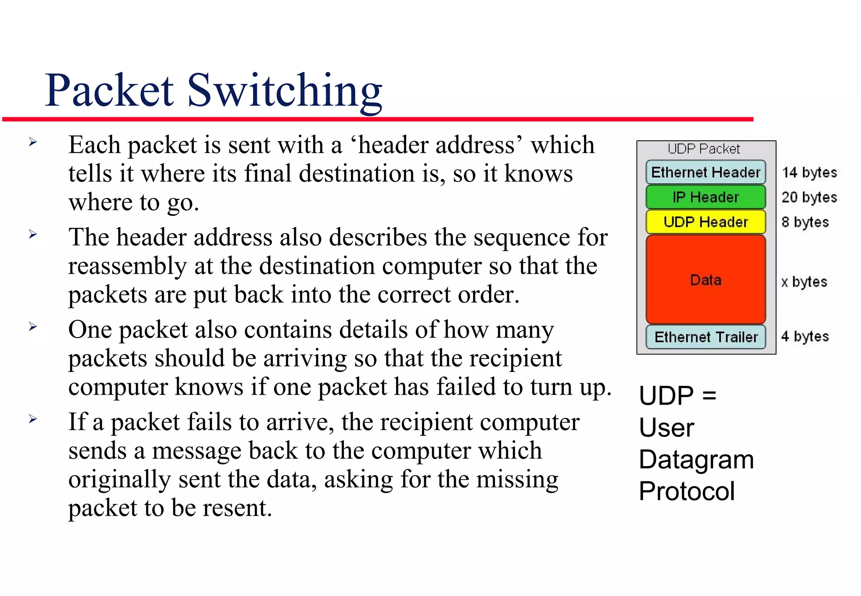
Packet switching

Slide 10
Features of packet switching
Data link and Network layer
Store and forward
Pipelining used
More Efficiency
More Delay

Slide 11
Packet switching
The total time formula in circuit switching:
Total Time=Setup Time+Transmission Time+Propagation Time+Teardown Time
Setup Time: This is the time taken to establish the circuit between the sender and the receiver. It involves signaling, negotiation, and allocation of resources.
Transmission Time: Once the circuit is established, data transmission occurs over the dedicated communication path. (message/bandwidth)

Slide 12
Propagation Time: This is the time it takes for a signal to travel from the sender to the receiver through the physical medium (e.g., cables, fibers). Propagation time depends on the distance between the sender and the receiver and the speed of propagation in the medium.(distance/speed)
Teardown Time: After data transmission is complete, the circuit is terminated, and resources are released. Teardown time involves signaling to close the circuit and deallocating resources.

Slide 13
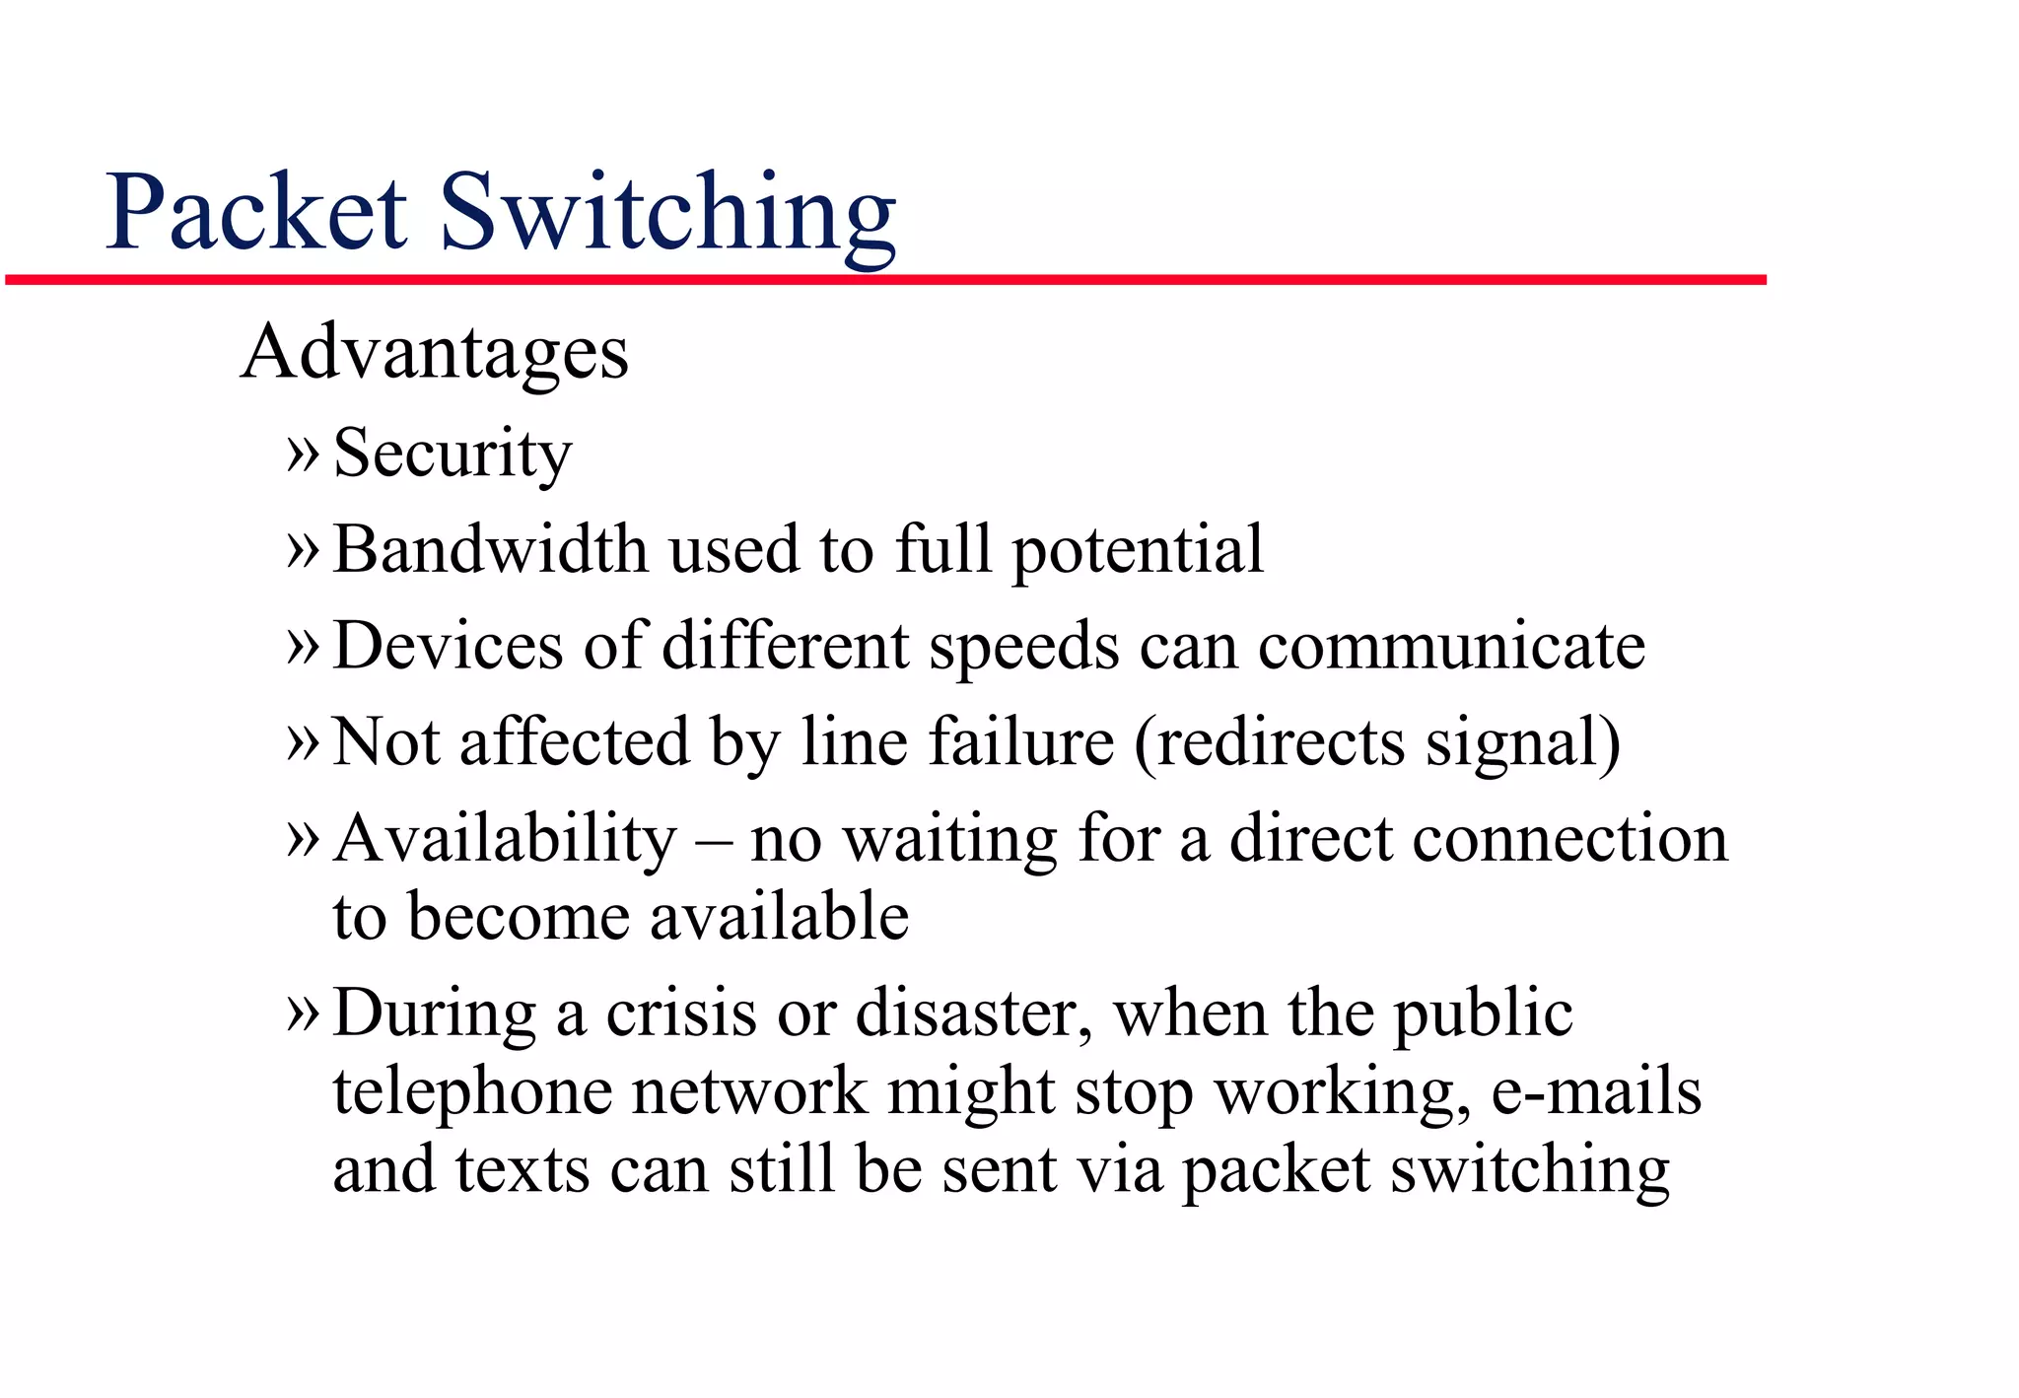
Packet Switching

Slide 14
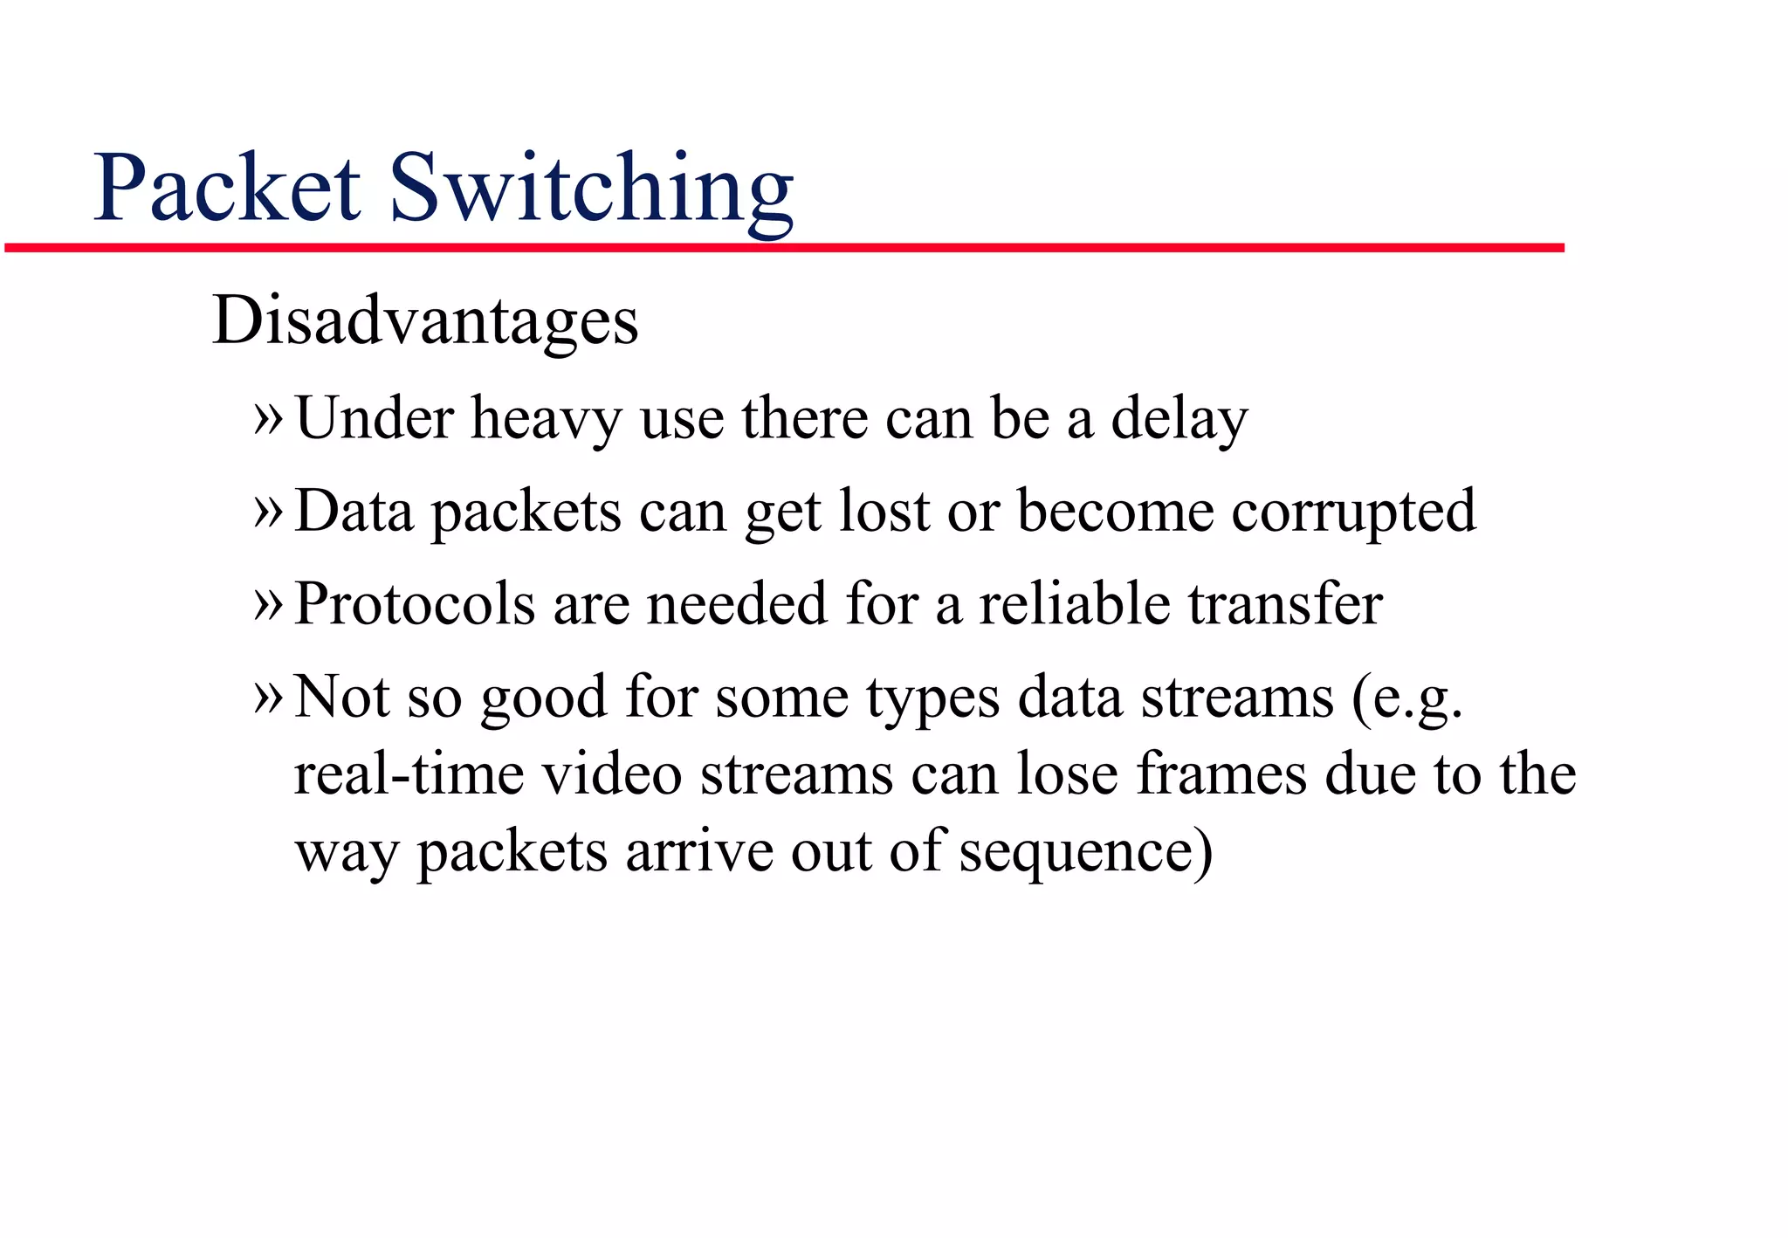
Packet Switching

Slide 15
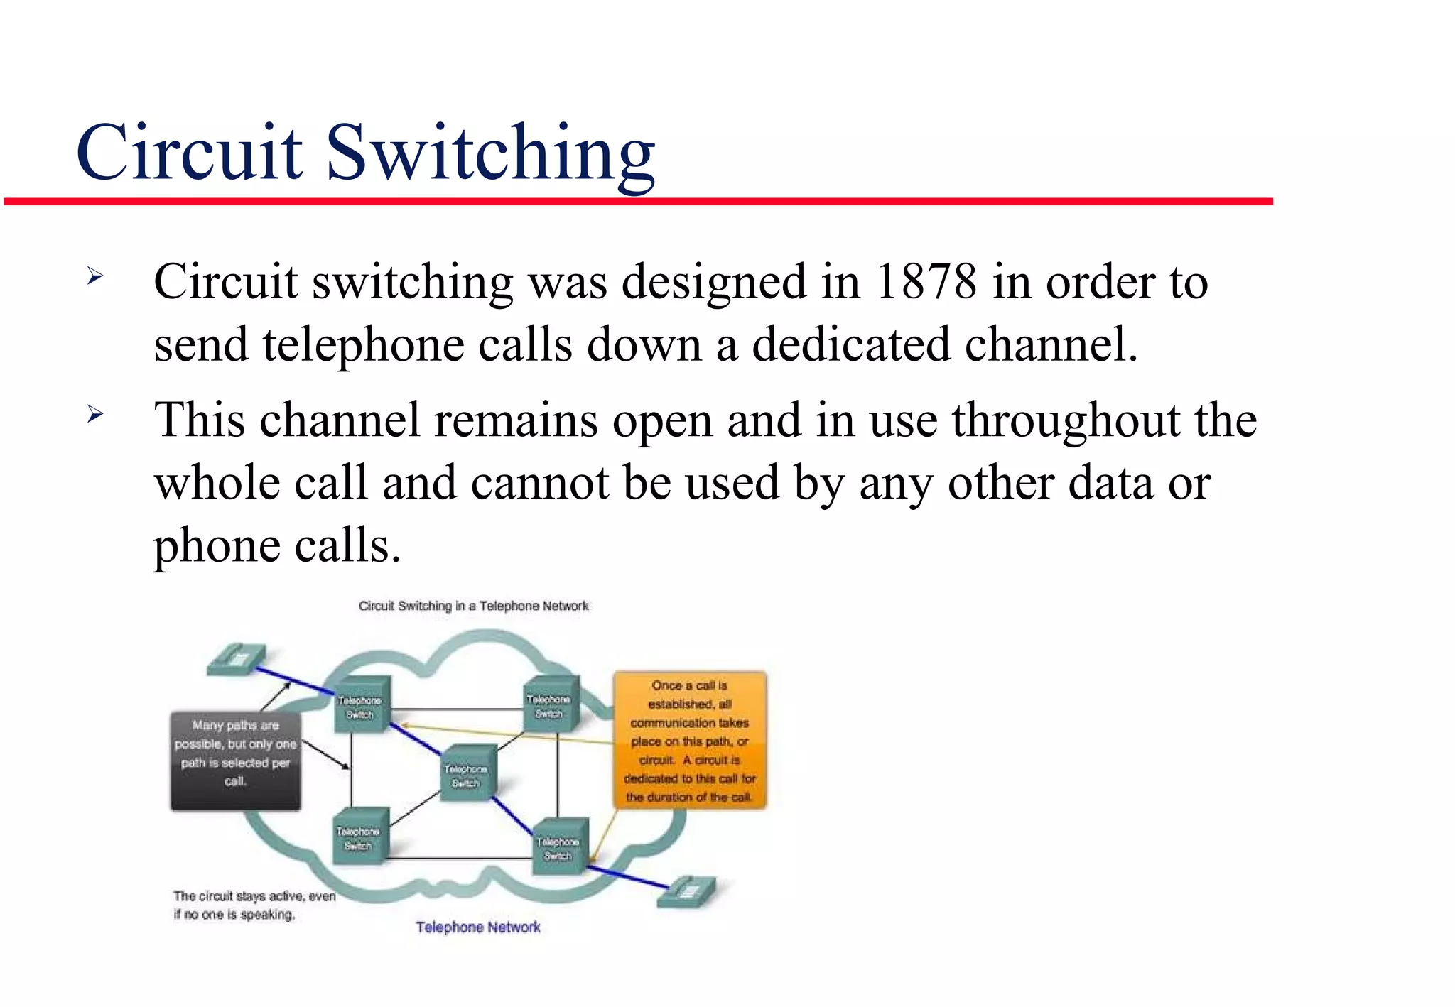
Circuit switching

Slide 16
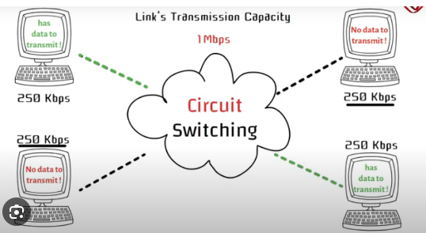
Circuit switching

Slide 17
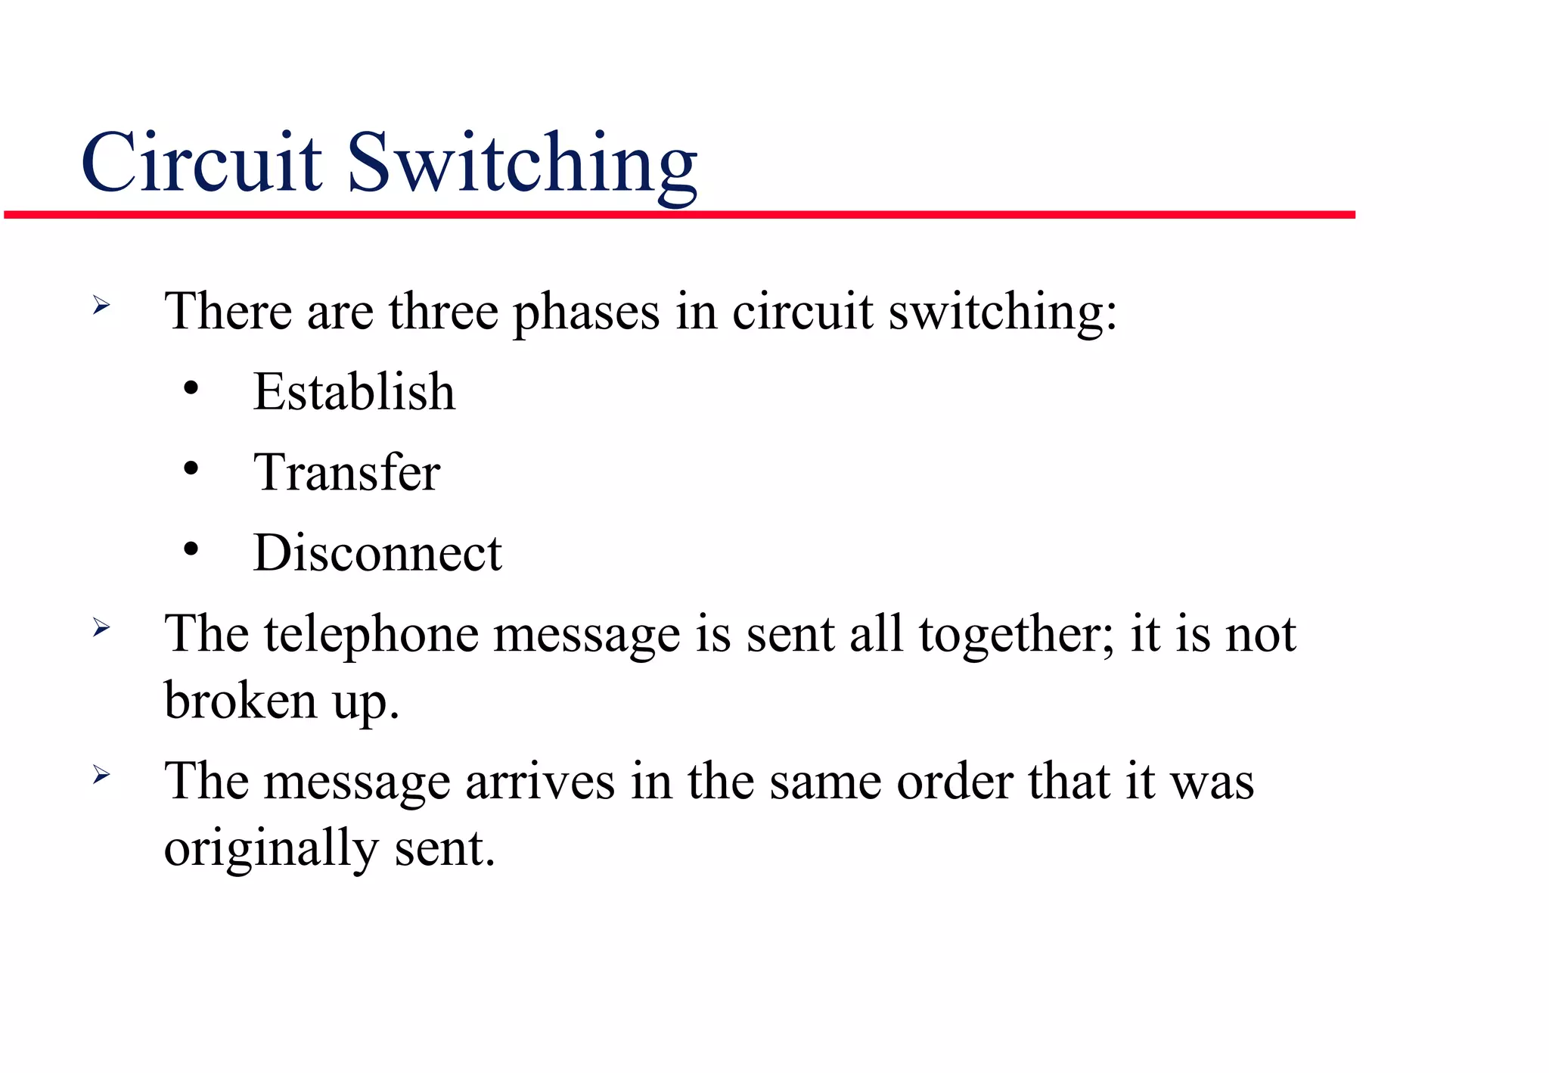
Circuit switching

Slide 18
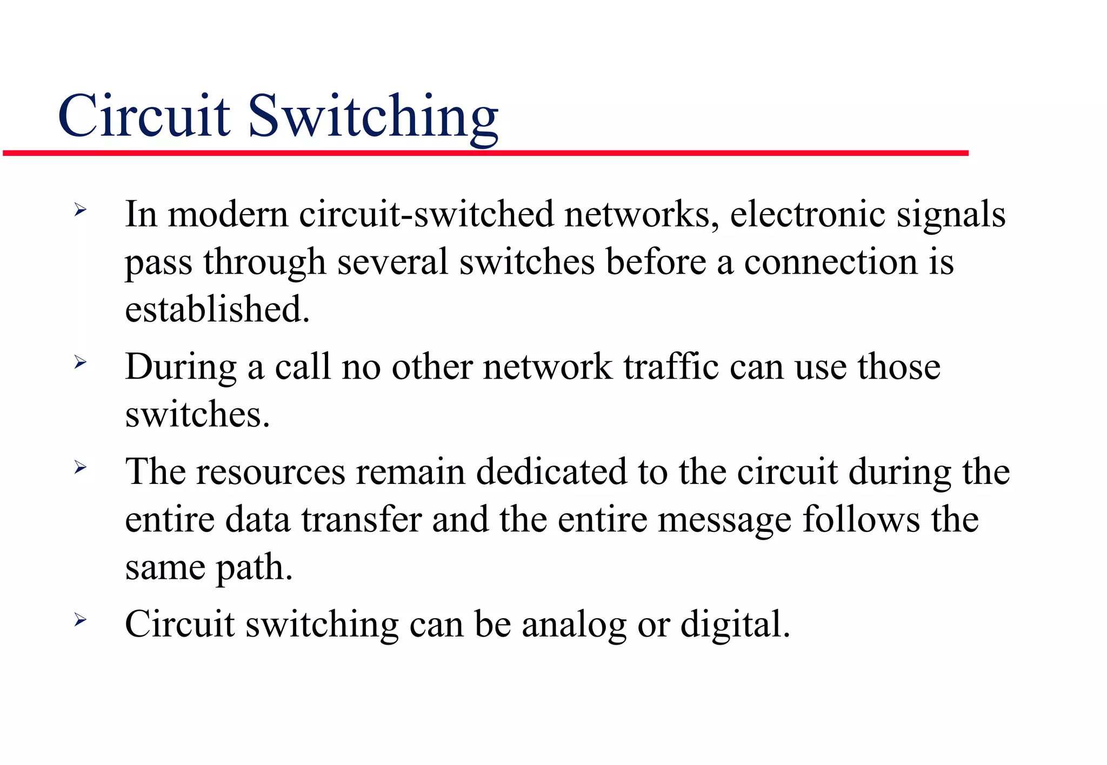
Circuit switching

Slide 19
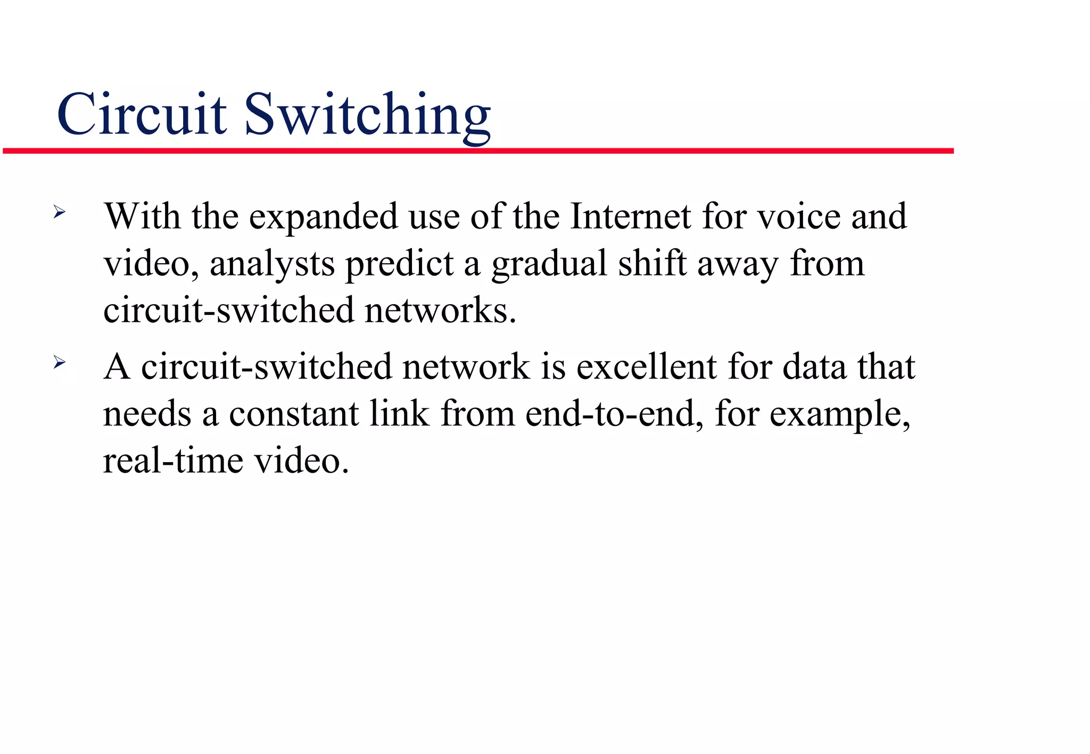
Circuit switching

Slide 20
Features of Circuit switching switching
Performed on physical layer
Contiguous flow
No headers
Less Efficiency
Less Delay

Slide 21
Circuit Switching
The total time in packet switching can be expressed as:
Total Time=Transmission Time+Propagation Time+Queuing Delay+Processing Delay
Transmission Time: The time taken to transmit the entire packet onto the network link. It depends on the size of the packet and the transmission rate of the link.
Propagation Time: The time it takes for a signal to travel from the sender to the receiver through the physical medium. It depends on the distance between the sender and the receiver and the speed of propagation in the medium.

Slide 22
Queuing Delay: The time a packet spends waiting in queues at intermediate network nodes (routers or switches) before being transmitted. It depends on network congestion and the queue management policies employed.
Processing Delay: The time taken by routers or switches to examine the packet header, make forwarding decisions, and possibly perform other tasks such as error checking or packet fragmentation.

Slide 23
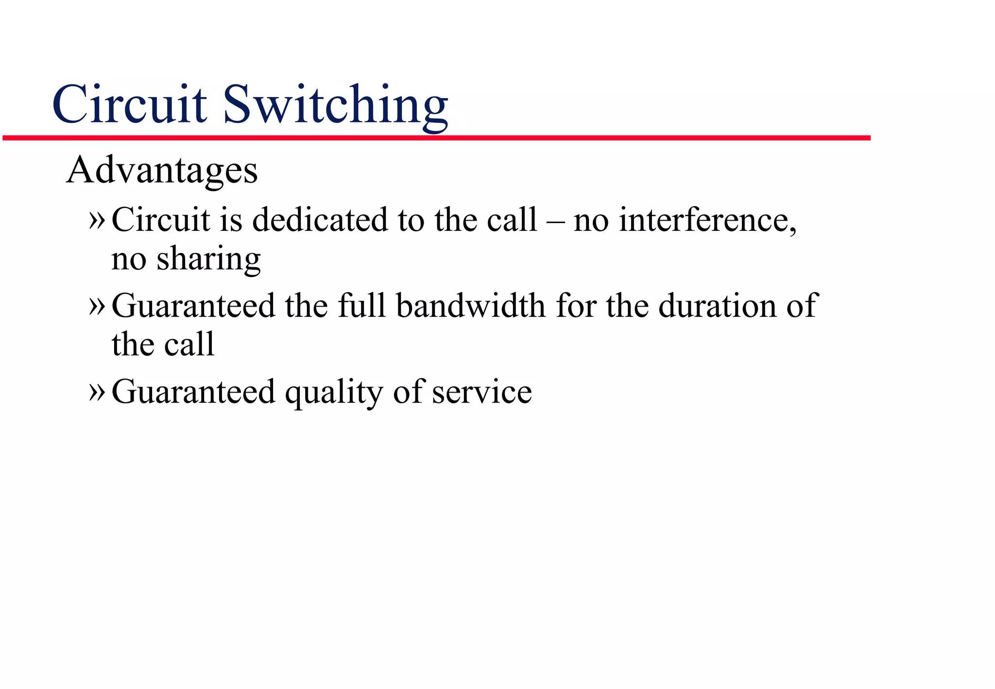
Circuit switching

Slide 24
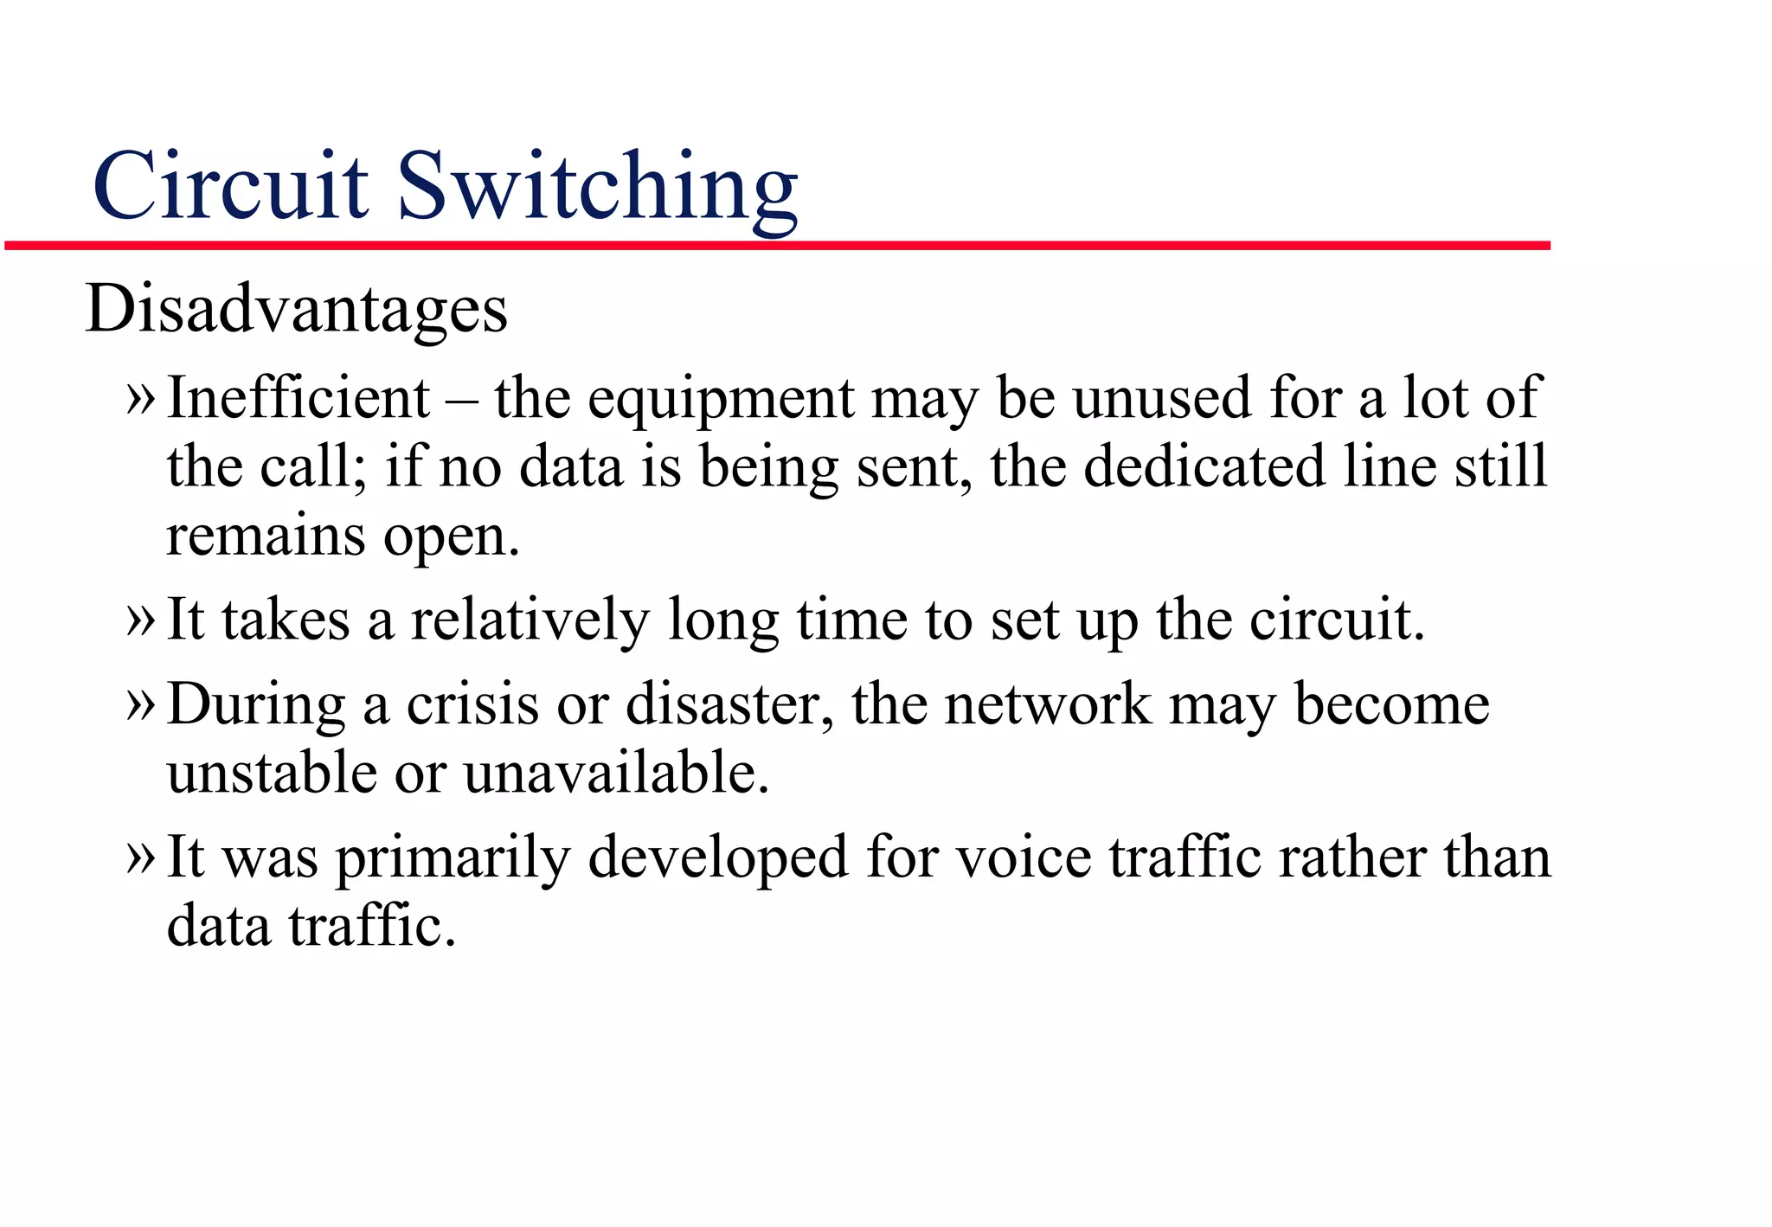
Circuit switching

Slide 25
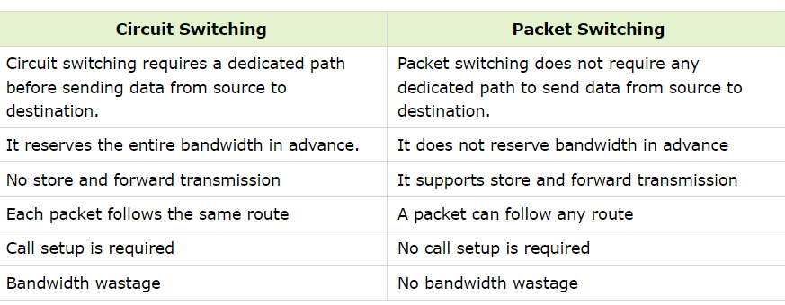
Comparison

Slide 26
Message switching
Message switching is a method of communication used in computer networks, where data is transmitted from one node to another through a series of intermediate nodes. In message switching, the entire message is received and stored at each intermediate node before being forwarded to the next node along the route to its final destination. This is in contrast to circuit switching, where a dedicated communication path is established for the duration of the transmission.

Slide 27
Features of Message switching
Features of Message Switching:
Store-and-Forward Mechanism: Messages are stored temporarily at each intermediate node before being forwarded to the next node. This allows for error checking and retransmission if necessary.
Routing: Intermediate nodes determine the optimal path for message delivery based on routing algorithms and network conditions.
Connectionless Communication: Message switching operates in a connectionless manner, where each message is treated independently. There is no need to establish a dedicated connection between sender and receiver.
Flexibility: Message switching can handle different types of data, including text, images, and multimedia, making it suitable for diverse communication needs.

